Slide 1
ALPHA COLLEGE OF ENGINNERING
BE MECHANICAL ENG.
1ST SEM
GROUP :-11
ME – D
DABHI DASHYANSINH.S 241
VEKARIYA TEJ.R 242
NIL PATEL.J 243
AKSHAY PATEL.A 244
PARTH PATEL 245
MOHIT VERMA.H 246

Slide 2
BUILDING PLANNING
Building are planned according to the fundamental principal of planning and bye-lows of municipal bodies .

Slide 3
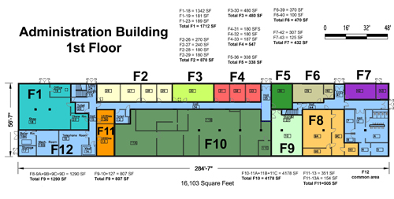

Slide 4
Building planning requires basic knowledge of principal of Architecture.
Main component of buildings
are foundation ,
masonry , doors , windows ,
stairs , floors , roof and many
other …..!!!

Slide 5
Building may be public building or residential building
like school , collages , office , hospital etc…!!
Industrial Buildings are workshops , ,warehouses & industrial sheds.
Industrial buildings are designed according to need of specific industrial process and purposes.
Planing and design of Industrial building should be earthquake resisant.

Slide 6
Industrial Building

Slide 7
Some points to know about Industrial building process :-
1. Layout of industrial building:-
2.Varias components of an industrial building:-
3. planning of industrial building :-
4. Requirements of an industrial building:-

Slide 8
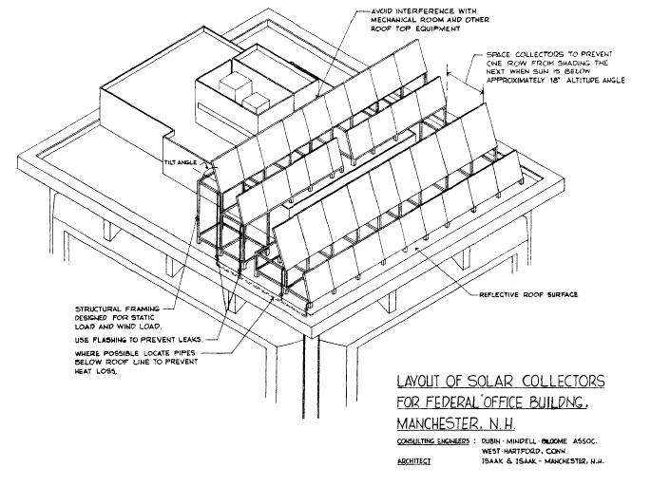

Slide 9
LAYOUT OF AN INDUSTRIAL BUILDING
A. Built up area :
50-60% of plot area :
-Factory
-Office
-Store
-welfare units
B. Open sky area :
40-50% of plot
- Roads
-Margin
-Parking

Slide 10
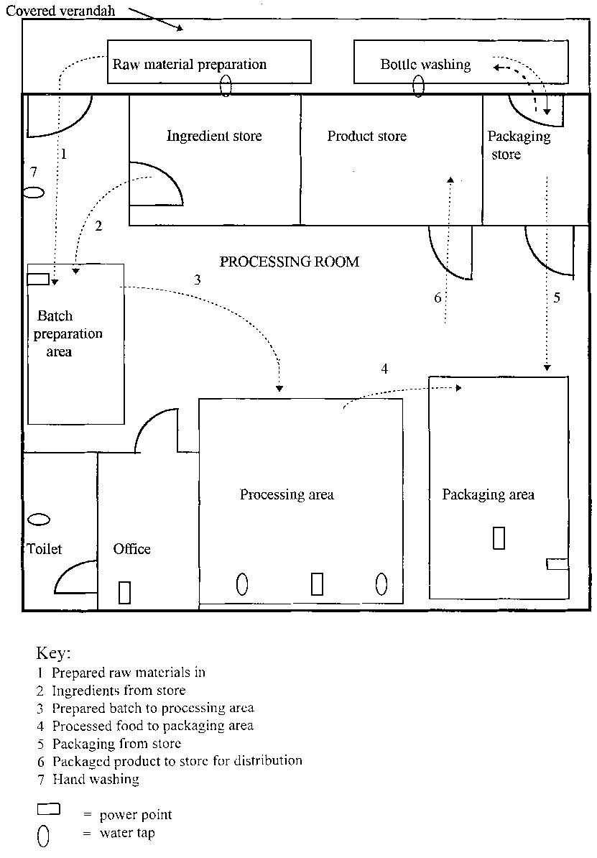

Slide 11
Planning of an industrial building is carried out by following considerations :-
1. LOCATION AND SITE : Industrial building should be so located that they do not encourage concentration of population in large urban centers.
It may be located at out side the towns.
It should be close to perennial water supply.
It should be with electric power supply and should permit easy drainage.
2. ORIENTATION AND LIGHTING : North light roofs can be used to take advantage of north light .
Adequate lighting within industrial building can be obtained by arranging sheds in the East and west direction and by providing glazed window in north and south walls.

Slide 12
3.SIZE OF INDUSTRIAL SHED :
The length of shed varying according to the requirement .
The minimum : 60 sq . m.
The maximum : 600 sq. m.
4. COVERED AREA OF INDUSTIARL SHED :
50 – 60 % Plot area .

Slide 13
5.ROADS : the area of roads should not exceed 20% of the total area of industrial plot.
6. PLINTH :
30 cm above crown of road.
7.HEIGHT OF ROOF : 4.20 m from plinth to tie level of roof.
8. ADMINISTRATIVE BUILDING FOR INDUSRIAES :
5% -10% of total estate area.

Slide 14
9.WINDOW AND WENTILATORS :
humid region : 20% floor area
hot and dry : 15% floor area
10. NUMBER AND SIZE OF DOOR :
Two per shed :-2.5m *2.5m (front)
2.5m * 1.8m (rear)
11.FLOORING : 4 to 5 cm thick cement concrete IPS and kotahstone flooring is also sutable for I.B.
12. ROOFING : Pitched roof of Galvanised iron sheet or Asbestose sheet.

Slide 15
13. WATER SUPPLY : natural water supply is advantages. Sufficient amount of water should be available.
14.DRAINAGE : should be proper drainage system for waste & waste water disposal.
15.SPAN : sheds of 10m and 13m span may be adopted in most cases.

Slide 16
Requirements of an Industrial Building :
1.Canteen : It is a place for refreshment and lunch with hot and cold drinks are available for industrial users.
Also provide with cooking space , cleaning area & drainage area.
The size is depend upon no. of workers.

Slide 17
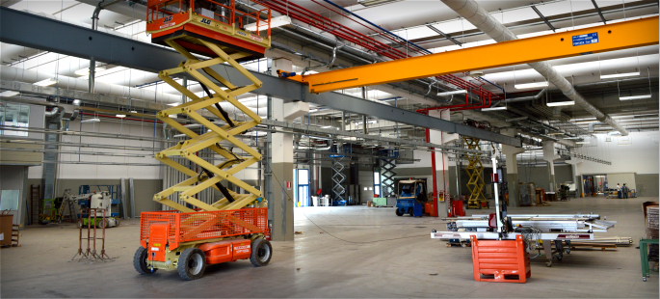
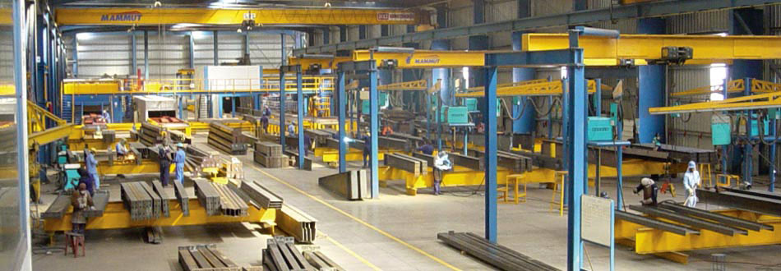

Slide 18
All records of raw material, stocks are kept in office .The telephone and internet connection for industry and production is carried out from office.
2.CLOCK ROOM : It is used for changing room for workers .
Lockers and racks are provided as per number of workers.
It should be well lighted and ventilated.
3.OFFICE AND ADMINISTRATION : Office building is provided for owner and administration staff. Salary or wedges and attendance for worker are managed from office.

Slide 19
4.ENTRANCE :
Minimum two entrances are provided with gates and security cabin in industry building.
Entry and exit gates are separately provided .
Entrance for workers and trucks may be separate or same .That should be sufficient wide to allow trucks inside area.

Slide 20
5.LOADING OR UNLOADING PLATFORMS :The goods received from trucks is unloaded on unloaded platforms. The goods to be transported from industry is loaded om loading platforms.
Space provided for stacking goods and trucks are generally open to sky.
Platforms must be strong surface , with water supply and provided with ramps.

Slide 21
7.SANITARY BLOCKS : sufficient no. of urinals and water closets should be provided in separate location in industry building for workers and office staff.
6.MEDICAL AID : In each industrial building primary treatment should be available to users. Quick medical aid should be available.
In some industry regular health check up of workers and advice with medicine & treatment is arranged by owner.

Slide 22
It must be with :
-separate location with male and female
-water supply and electrification
-well ventilated and maintained
-must wash regularly.

Slide 23
8.STORAGE BUILDING :
They are covered building . They store raw material as well as goods or product of industries . Their size depends upon capacity of industry and should be well protected and ventilated.

Slide 24
9.PARKING :
* cars – 20m.sq /veh.
*Two wheeler – 3m.sq/veh.
Cycle stand for workers parking area is with roof shelter.
10.ALL WEATHER ROADS : Roads provided should be all weather road . They are single lane connected with entry and exits . Rods are provided to connect various unit of Industrial Building.

Slide 25
11.FACTORY SHED :
It is a space where manufacturing work is carried out. NO. workers are working there. Machineries and plants are provided there. They are covered with still truss and roof sheets. Should be well ventilated and lighted. Sufficient door and windows are provided for ventilators. The flooring should be non-slippy and durable.

Slide 26
12.WATCHMEN/ SECURITY CABINEA :
Security purpose watchmen is hired in industry .
They check entry and exits of trucks with appropriate goods loading.
They check entry and exits of workers.
They restrict of unauthorised persons in industrial building.

Slide 27
13. DRINKING WATER :
14. TELEPHONE :
15. CIRCULATION SPACE :

Slide 28
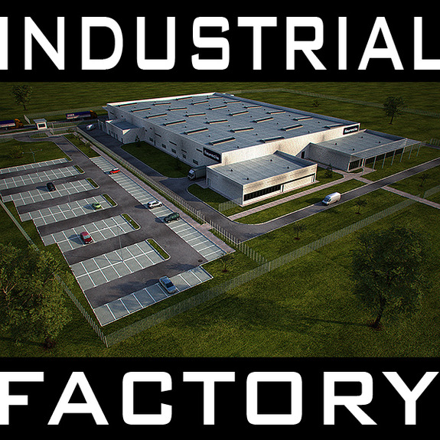

Slide 29
!!..THANK YOU …!!
FOR CO-OPEARTE AND HUMBLE ATTENTION …!!

